Slide 1
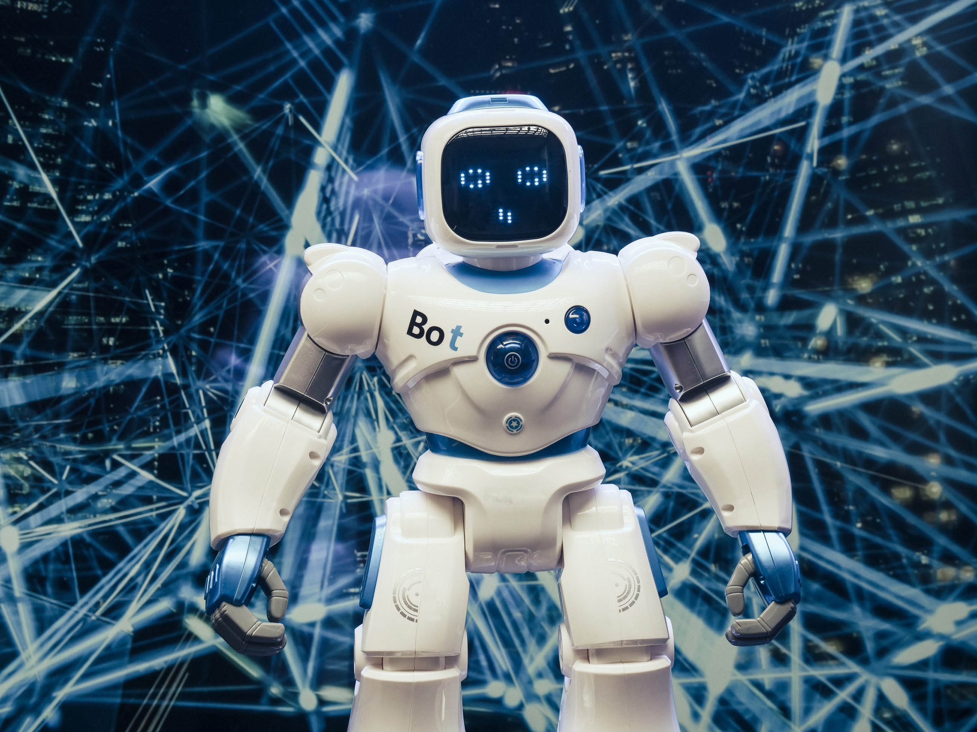





Overview and application of Deep Learning
"Deep learning: where data whispers, and algorithms listen."

Slide 2




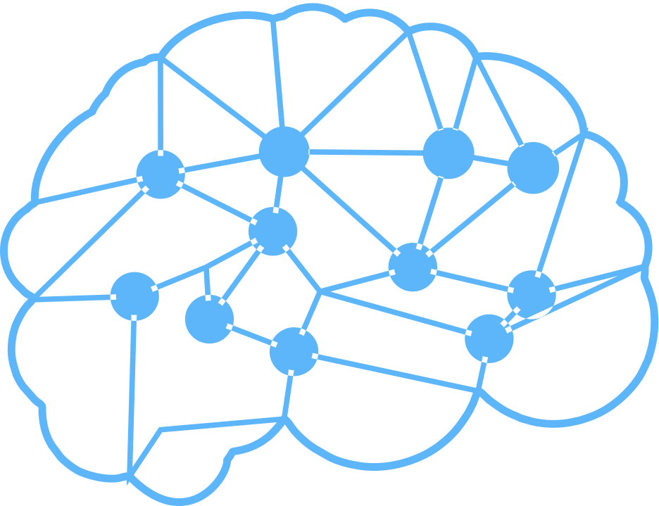
Topics Covered in the Presentaion
01
Introduction to Deep Learning
02
Neural Network
03
Types of Neural Networks
04
Deep Learning Applications
05
Challenges and Limitations
06
Future Trends in Deep Learning

Slide 3





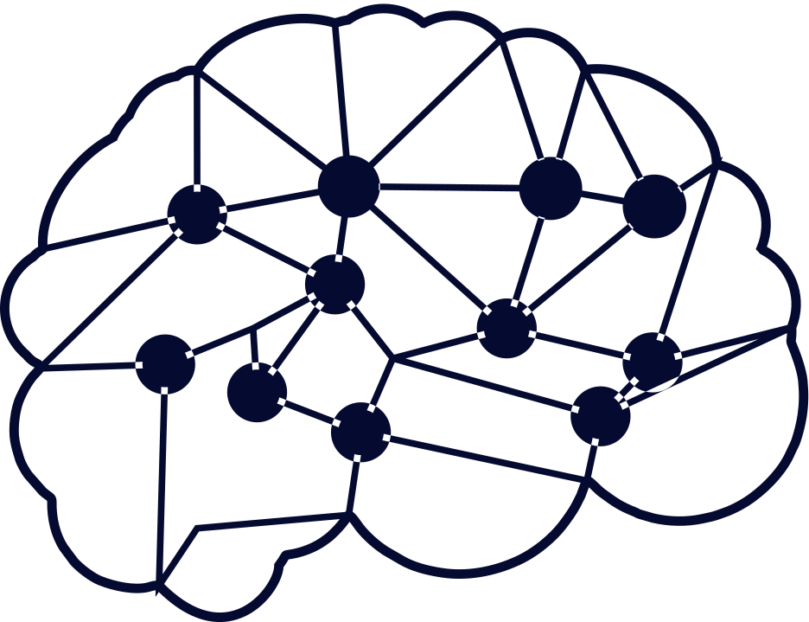
Introduction to Deep Learning
Definition :
1.
Deep learning is a subfield of machine learning where concerned algorithms are inspired by the structure and function of the brain called artificial neural networks.

Slide 4
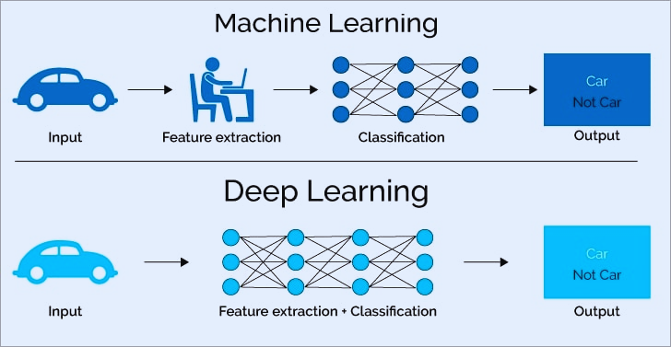
Introduction to Deep Learning
How Deep Learning is Different by Machine Learning?
2.

Slide 5

Neural Networks
Neural networks are a fundamental component of deep learning. They are modeled after the structure of the human brain, with interconnected nodes that process information and make decisions based on that information.
The architecture of neural networks is made up of an input, output, and hidden layer.

Slide 6


Types of Neural Network
Convolutional Neural Network
Recurrent Neural Networks
Consist of convolutional layers, pooling layers, and fully connected layers.
Primarily used for image and video processing tasks.
rr
Designed to handle sequential data, such as time series or text.
Feedback connections, allowing information to flow in loops.
Widely used in tasks such as natural language processing, speech recognition, and machine translation.

Slide 7
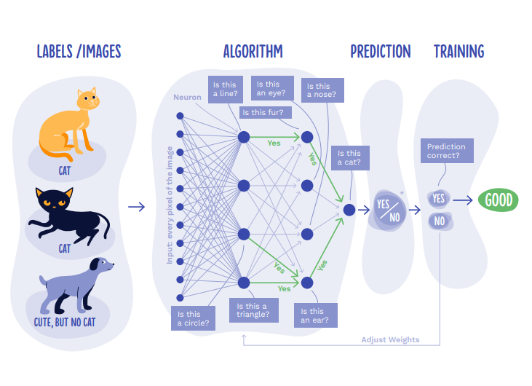
Working of Neural Networks

Slide 8

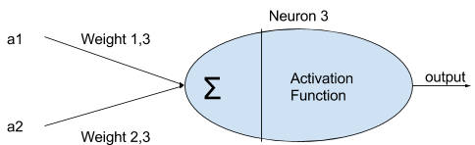
Activation Function
An Activation Function decides whether a neuron should be activated or not.

Slide 9
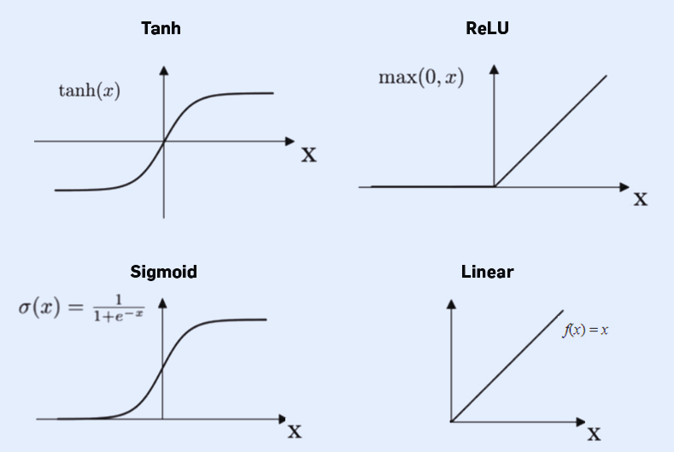
Types of Activation Function

Slide 10
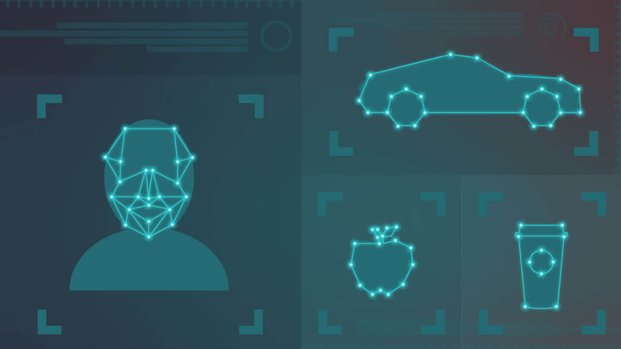

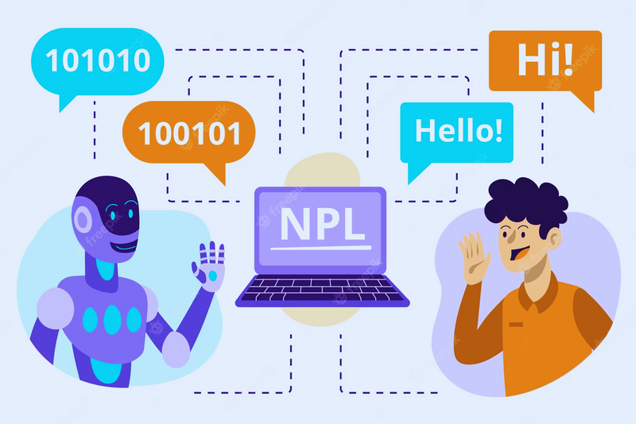
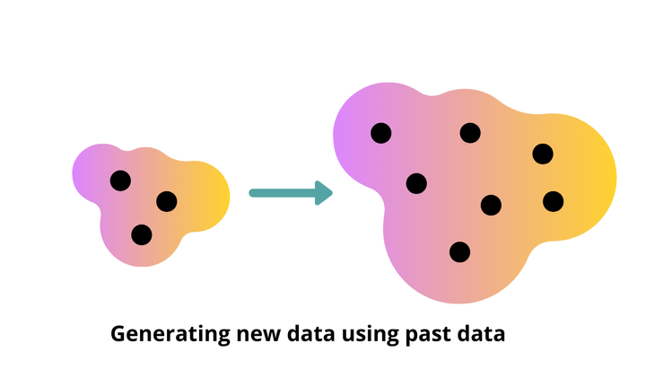
Applications of Deep Learning
Image recognition
Speech recognition
Natural language processing
Generative models

Slide 11
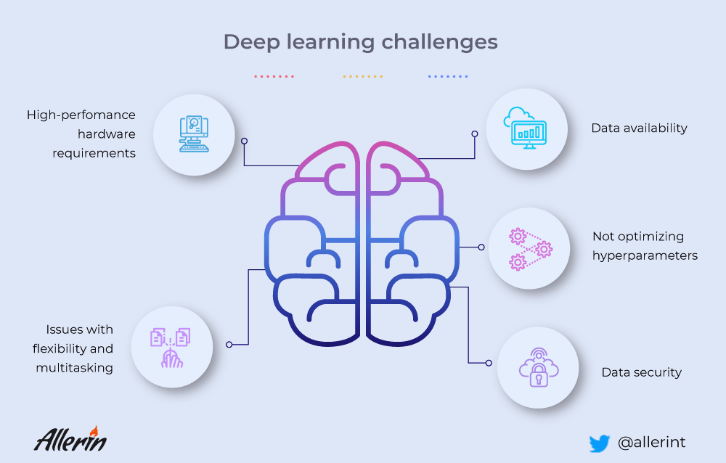
Challenges & Limitations

Slide 12
Future Trends in Deep Learning
The future of deep learning is bright, with the potential to revolutionize numerous industries and solve some of the world's biggest problems. As deep learning models become more advanced and powerful, they will be able to tackle increasingly complex tasks such as :
1.Explainable AI
3. Climate Modelling
2. Drug Discovery
4. Meta-Learning
5. Hardware Advancements

Slide 13



Thank You

